Slide 1
TEXT RECOGNITION
--Caesar Cat

Slide 2
Definition
Write an optical character recognition application that identifies and recognizes printed text within an image

Slide 3
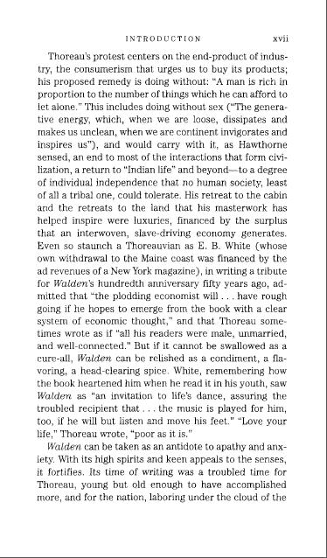
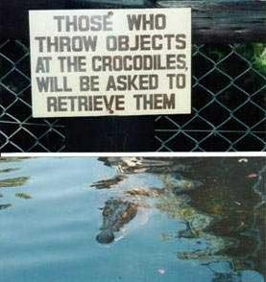
First of All
Text Only
OR
With Picture

Slide 4
Steps of Identifying Text Only
Color Analysis
Cut Chars
Denoising
Send Char to OCR Engine
Using Returned Chars to Produce the Text.
Cut Lines
Cut Words
Correct the Output

Slide 5
Cut Lines

Slide 6
Cut Words

Slide 7
Cut Chars

Slide 8
OCR Engines
Microsoft MODI
Free
Need to Install with Office 2003
Tesseract by Google
Open Source

Slide 9
Steps of Identifying Text w/ Picture
Range the Text Area
Pick the Text Color
Apply the Steps of Identifying Text Only

Slide 10
Some Issues

Slide 11
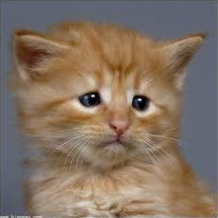
Since this is informal, let’s stop here.
Any questions and suggestions.

